Slide 1

Rise of Civilizations
Image src: http://vignette4.wikia.nocookie.net/steamtradingcards/images/5/5a/Age_of_Empires_II_HD_Edition_Background__A_Deadly_Game.jpg/revision/latest?cb=20140509061420
Group 13 Development Project
Akhil Kateja, Adil Qaisar, Andriy Serafyn,
Himanshu Anand

Slide 2
Game Overview
The Rise of Civilizations is a turn based strategy game wherein the player has an option to play either against an AI or against other players on his/her local area network.
The game requires players to build a base where they build their units and eventually defeat all the other players that are not in their team.
This presentation will cover the functional requirements, non-functional requirements, software architecture, project issues , cost estimate and project retrospective.

Slide 3
Functional Requirements Overview
The system must allow the player to play in Single player or Multi Player modes or resume a previously saved game. The player will engage in conquests, build units, trade resources and capture resources.
The system must also allow the player to proceed to next level, provided he/she fulfills the requirements of that level.

Slide 4
Non-Functional Requirements Overview
This game shall be usable by anyone who possesses very basic computer skills.
There should be no loss of user data in the event of a system failure.
The game must execute and run at least 120 fps (frames per second).
The product shall be able to provide assistance for all users 24/7 through an email automated system.

Slide 5
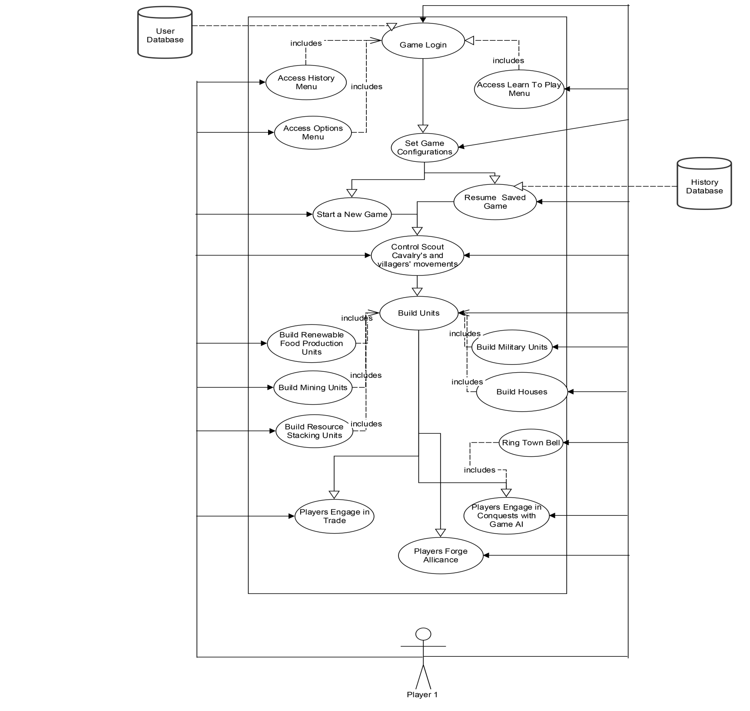
Use Case Diagram

Slide 6
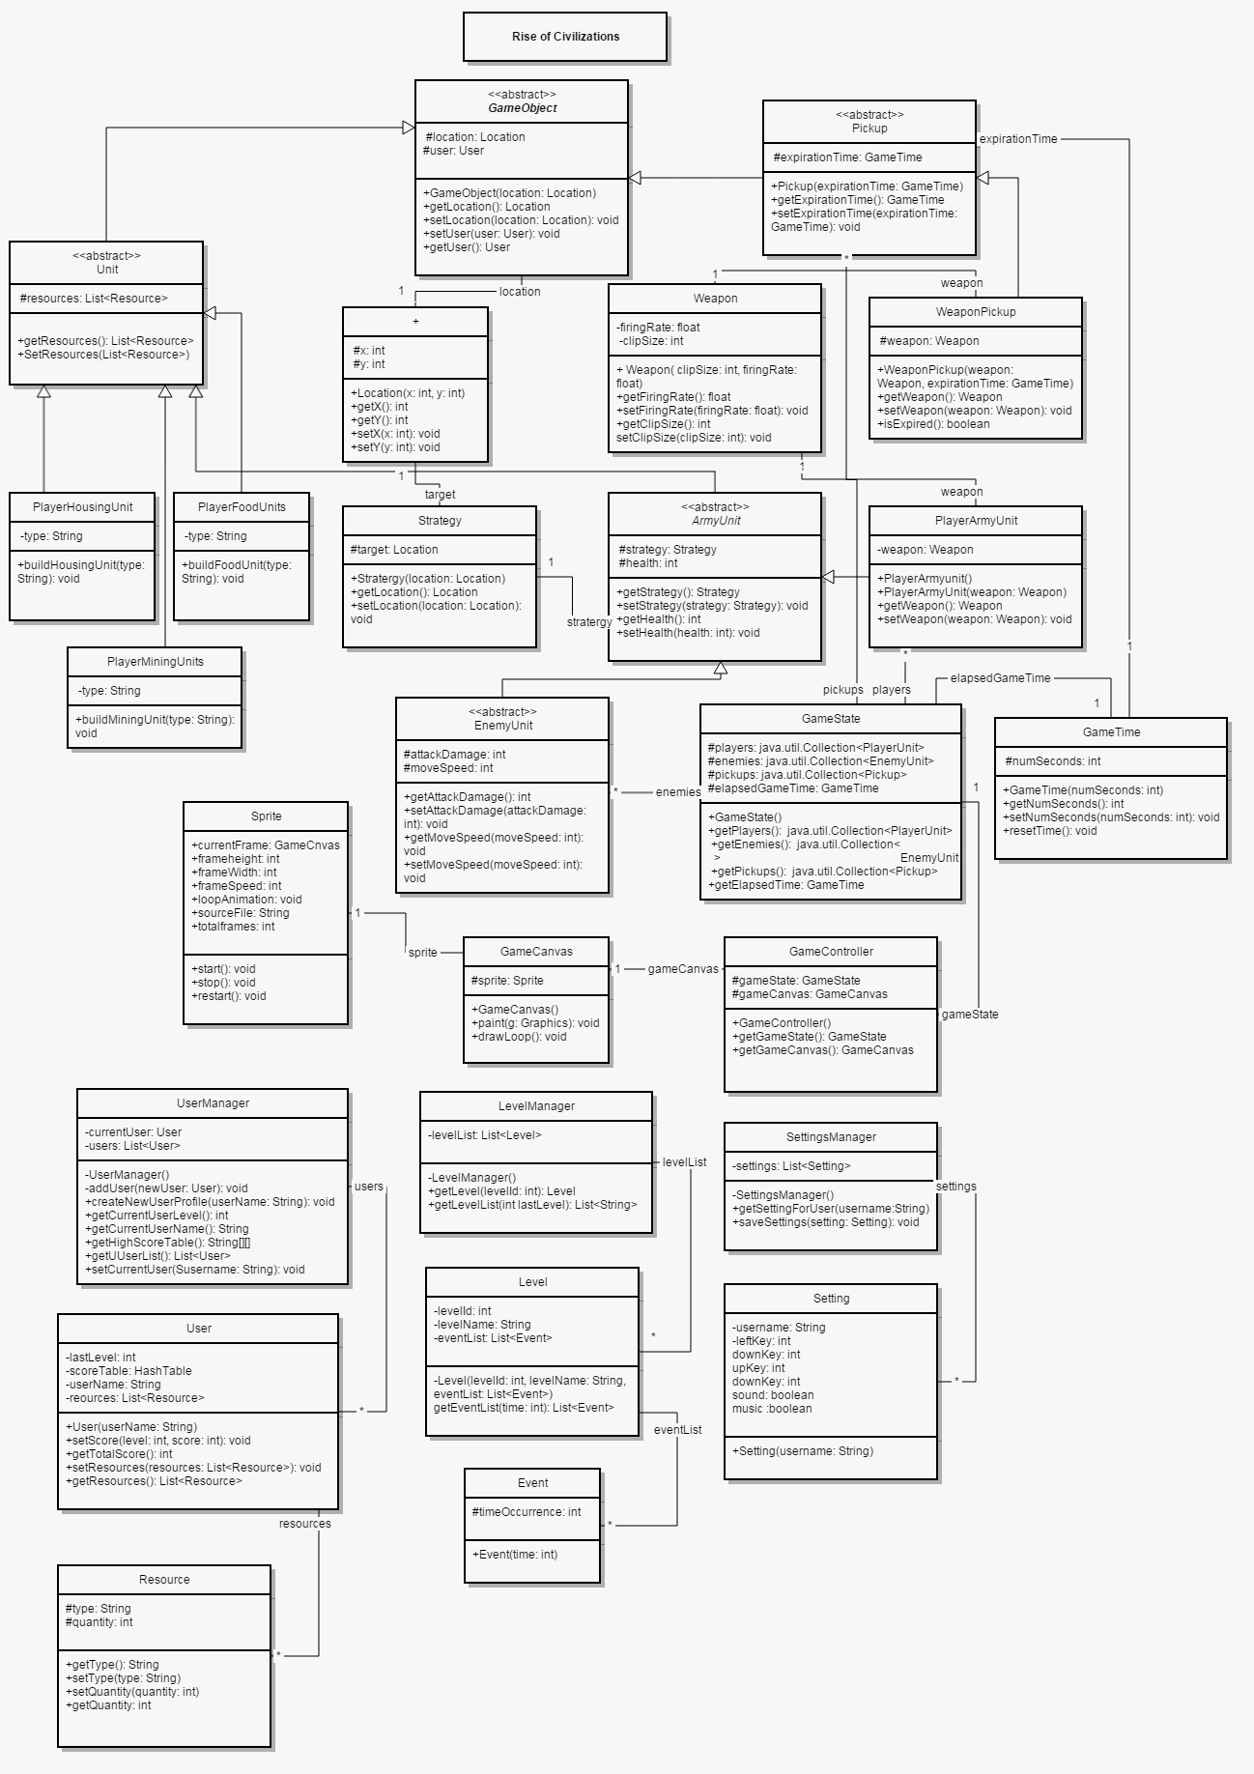

Slide 7
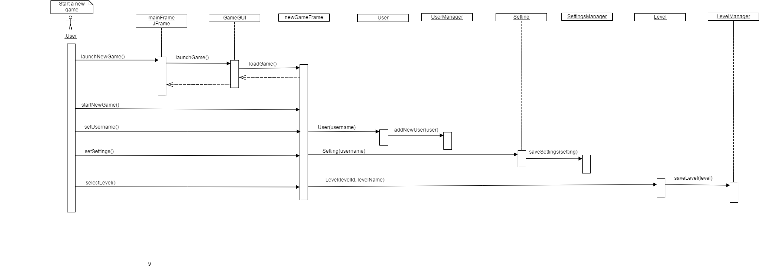
Sequence Diagram

Slide 8
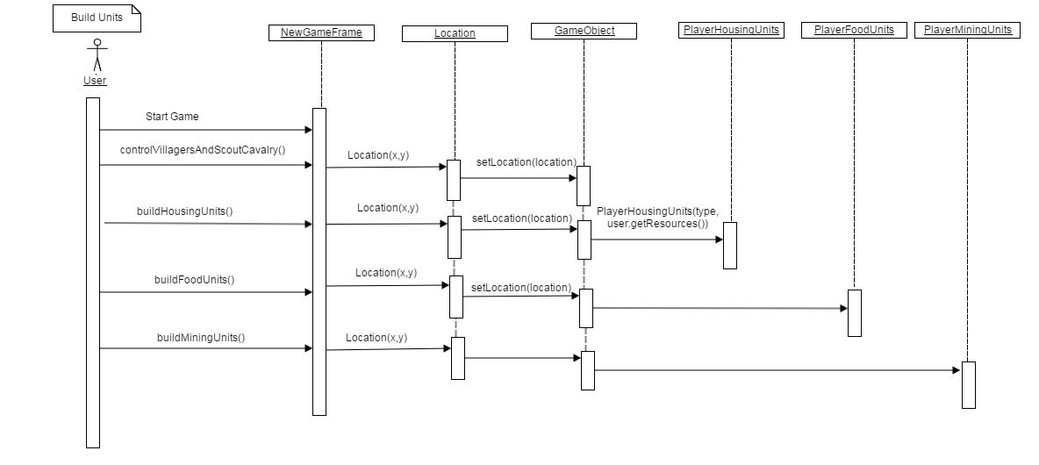
Sequence Diagram

Slide 9
Sequence Diagram

Slide 10
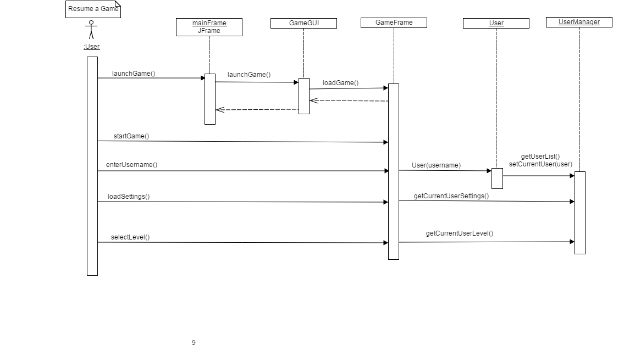
Sequence Diagram

Slide 11
Project Issues
Currently, we have decided to launch the game as an executable file.But, we believe that we could make the game available online. This will allow us to reach more people and will provide the users a more realistic gaming experience.
Since ready-made products provide minimal costs and better technical support, it would be wiser to go that route for some hardware or software during the development of the game.For instance, MySQL ,Microsoft SQL Server could be used for storing the user and game information.

Slide 12
Project Issues
The project will be developed using Software Development Life Cycle.However, some circumstances are unique to a particular product and could require alteration to the life cycle.
Care should be taken to encompass all the functional requirements.

Slide 13
Cost
The cost estimate is the amount of resources estimate each type of deliverable will take to produce within the environment.
Software development, given the intangible nature and uniqueness of software, is inherently difficult to estimate and schedule.
In the beginning the knowledge of the game will be general, so we could reflect this vagueness by making the cost estimate a range rather than a single figure.

Slide 14
Cost
With increase in the knowledge of the game, function points is suggested for doing cost estimation as it is possible to make easy comparisons with other products.
Waiting Room could be used for planning the future releases of the product, wherein a version number is attached to the requirement and when the requirement reaches closer to implementation, cost and benefit details could be attached to that requirement.

Slide 15
Project Retrospective
The development project is being developed using the Waterfall software. In order to ensure the effectiveness of the retrospective, it is very essential that the team coding the project adopt good meeting practices.This could include providing advance notice of the meeting, promote a team norm that participants will be prompt in their arrival, etc.
Choose an effective way to represent data for easy understanding and usage during the retrospective.
Main course activities should be used to gather data,check on the team’s morale and seek improvements.

Slide 16
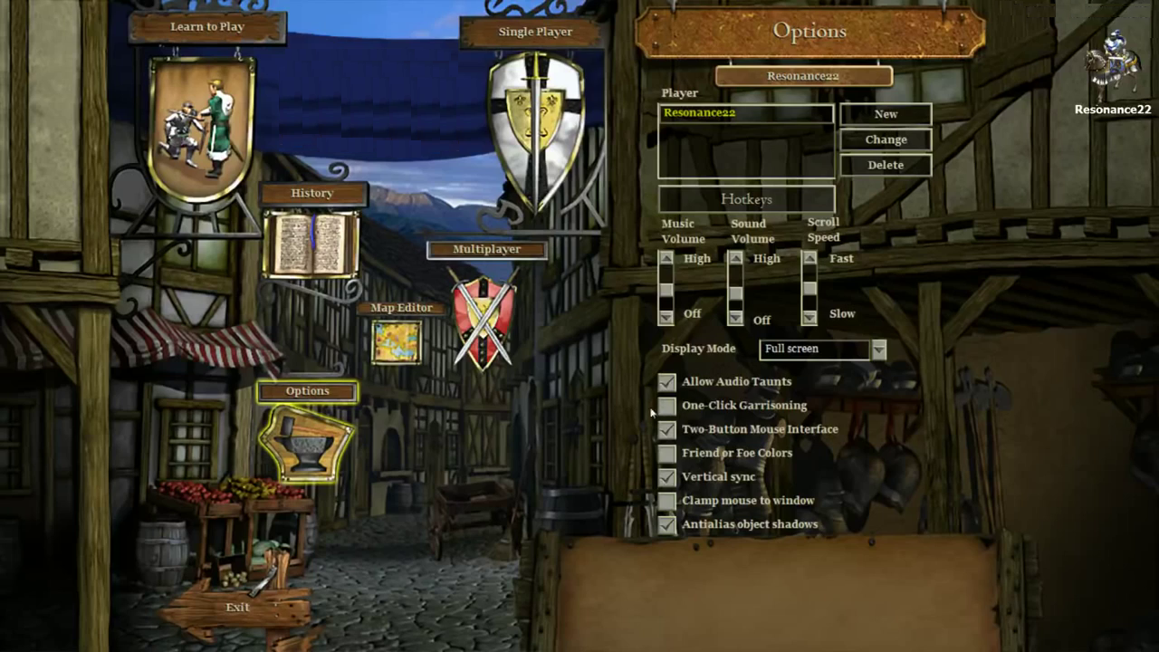
Image source: https://www.youtube.com/watch?v=mMey4_d-itA&list=PLEQWWx1EYwpqmXRFnWeBLh77n4tzujrs2&index=1

Slide 17
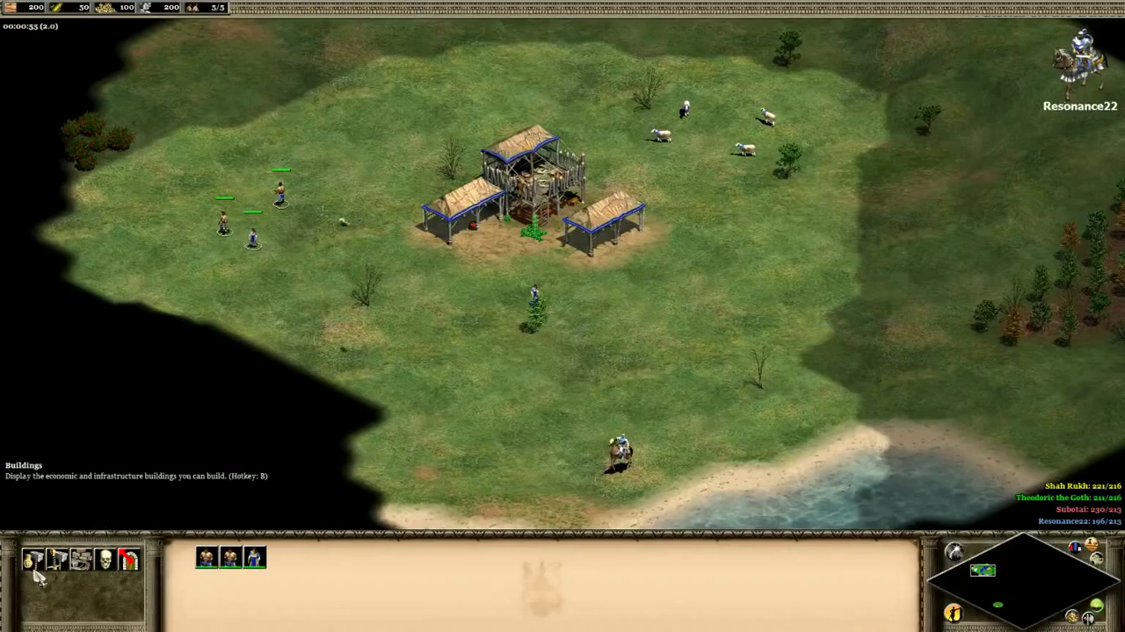
Image source: https://www.youtube.com/watch?v=mMey4_d-itA&list=PLEQWWx1EYwpqmXRFnWeBLh77n4tzujrs2&index=1

Slide 18
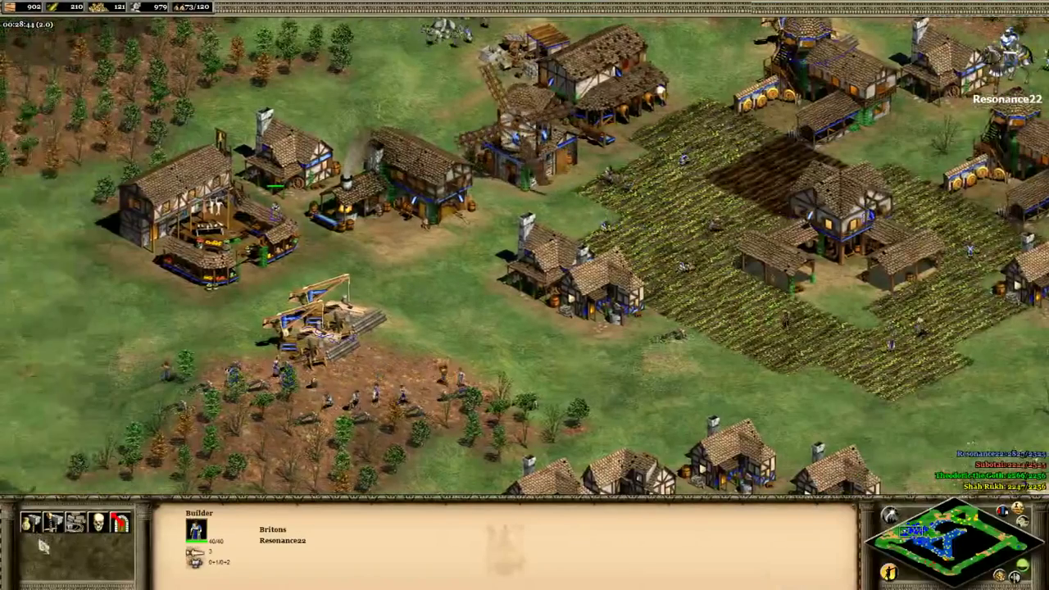
Image source: https://www.youtube.com/watch?v=mMey4_d-itA&list=PLEQWWx1EYwpqmXRFnWeBLh77n4tzujrs2&index=1

Slide 19
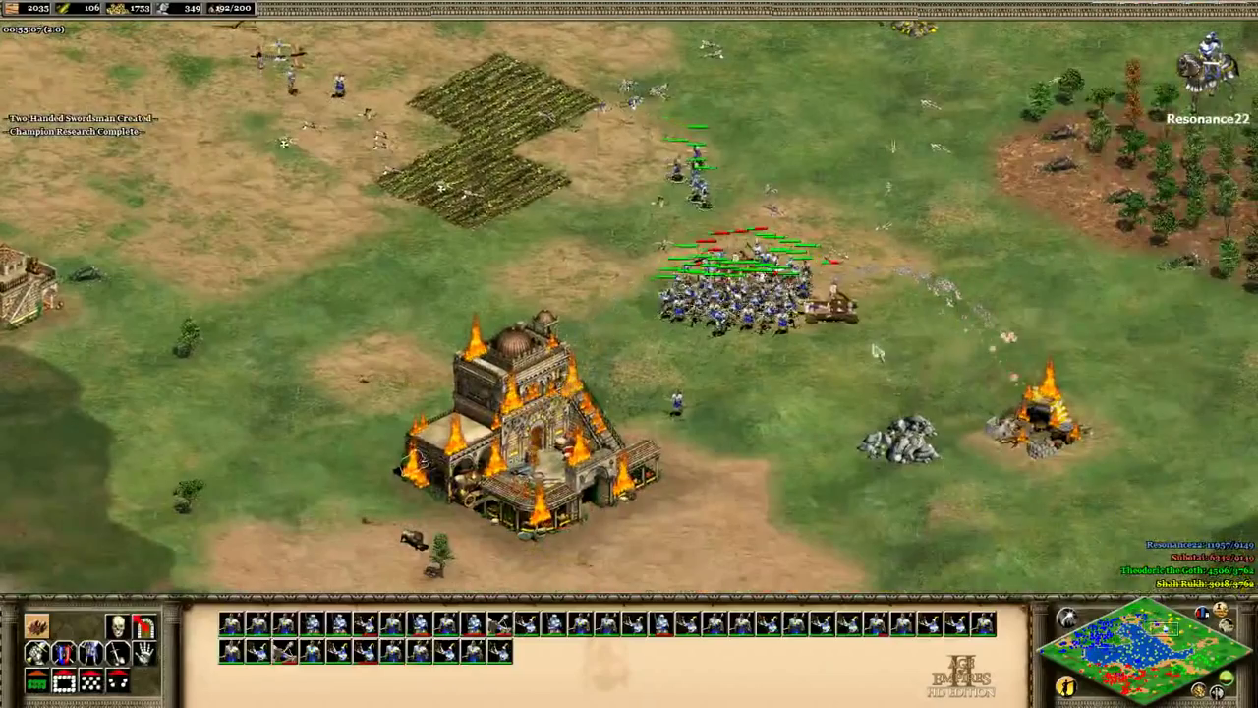
Image source: https://www.youtube.com/watch?v=mMey4_d-itA&list=PLEQWWx1EYwpqmXRFnWeBLh77n4tzujrs2&index=1

Slide 20
Thank You

